Slide 1
Retrieval-Augmented Generation (RAG)
Topics covered
Introduction to Retrieval Augmented Generation (RAG)
Evolution of Language Models to Retrieval-Augmented Approaches
The RAG Architecture: Combining Retrieval and Generation
How Does RAG Work?
Use Cases of RAG
Advantages of RAG
Disadvantages of RAG
Potential Applications of RAG
Limitations and Challenges of RAG
Future Developments in RAG
Practical Implementation Tips
Guidance on cloud services for RAG, no code chatbots, designing engaging UI for RAG apps, and integration with existing platforms.
Harnessing Opensource Tools for RAG

Slide 2

Retrieval-Augmented Generation (RAG)
Retrieval-Augmented Generation (RAG) is a powerful technique that combines language models with knowledge retrieval to generate more informative and coherent responses. It leverages both the generative capabilities of language models and the factual knowledge stored in large databases.

Slide 3
Evolution of Language Models to Retrieval-Augmented Approaches
Language models have long been the backbone of natural language processing, but their limitations in providing contextual and grounded information have led to the emergence of more advanced techniques. RAG builds upon the foundation of traditional language models by incorporating retrieval systems, which can access and utilize relevant external information to generate more accurate, coherent, and informative text.
The development of RAG is a culmination of decades of progress in natural language processing, from the early days of rule-based systems to the rise of neural networks and the increasingly sophisticated language models we see today. By bridging the gap between language models and retrieval systems, RAG represents a significant step forward in the field, paving the way for more versatile and powerful natural language generation capabilities.

Slide 4
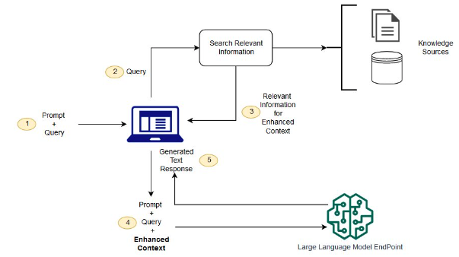
The RAG Architecture: Combining Retrieval and Generation

Slide 5
How Does RAG Work?
Retrieval
Generation
Iterative Process
RAG first retrieves relevant information from a knowledge base to complement the input given to the language model.
The retrieved information is then combined with the input and used to guide the language model's generation process, resulting in more informed and coherent outputs.
This retrieval-generation cycle can be repeated iteratively to refine the output and incorporate additional relevant information.

Slide 6
Use Cases of RAG
1
Question Answering
2
Dialogue Systems
RAG can provide more accurate and comprehensive answers by retrieving relevant information from knowledge bases.
RAG can help dialogue systems engage in more natural and informative conversations by drawing upon relevant knowledge.
3
Summarization
4
Content Generation
RAG can generate more meaningful and coherent summaries by incorporating key facts and details from external sources.
RAG can be used to create more informative and well-researched content, such as articles, reports, or essays.

Slide 7
Advantages of RAG
Improved Accuracy
Enhanced Coherence
RAG can generate more accurate and factually correct outputs by leveraging knowledge from diverse sources.
The integration of retrieved information helps RAG produce more coherent and contextually relevant responses.
Increased Flexibility
Reduced Hallucination
RAG can adapt to a wide range of tasks and domains by accessing relevant knowledge as needed.
RAG can mitigate the tendency of language models to generate factually incorrect or irrelevant content.

Slide 8
Disadvantages of RAG
Complexity
Dependency on Knowledge Bases
Potential Biases
RAG models can be more complex and computationally expensive to train and deploy compared to traditional language models.
The information retrieved from knowledge bases may reflect societal biases or inconsistencies, which could be amplified in the generated outputs.
RAG's performance is dependent on the quality and coverage of the knowledge bases it can access, which may be limited.

Slide 9




Potential Applications of RAG
Research Assistance
Educational Applications
Healthcare and Medicine
Customer Service
RAG-powered chatbots can provide more informative and tailored responses to customer inquiries.
RAG can aid researchers by providing relevant background information and insights from the literature.
RAG can be used in educational settings to generate personalized learning content and answer student questions.
RAG can assist medical professionals by providing relevant clinical information and decision support.

Slide 10
Limitations and Challenges of RAG
1
Knowledge Gaps
RAG is limited by the completeness and accuracy of the knowledge bases it can access, which may have gaps or inconsistencies.
2
Contextual Understanding
Effectively incorporating contextual information into the retrieval and generation process remains a challenge for RAG.
3
Transparency and Interpretability
Explaining the reasoning behind RAG's outputs and making the system more transparent and interpretable is an ongoing research area.

Slide 11




Future Developments in RAG
Improved Knowledge Bases
Multimodal Integration
Reinforcement Learning
Ethical Considerations
Incorporating visual and other modalities into the retrieval and generation process can enhance the capabilities of RAG.
Applying reinforcement learning techniques to RAG can help the system learn to generate more optimal responses.
Addressing ethical concerns, such as bias and misinformation, will be crucial for the responsible development of RAG.
Advancements in knowledge extraction and curation will lead to more comprehensive and accurate knowledge bases for RAG.

Slide 12
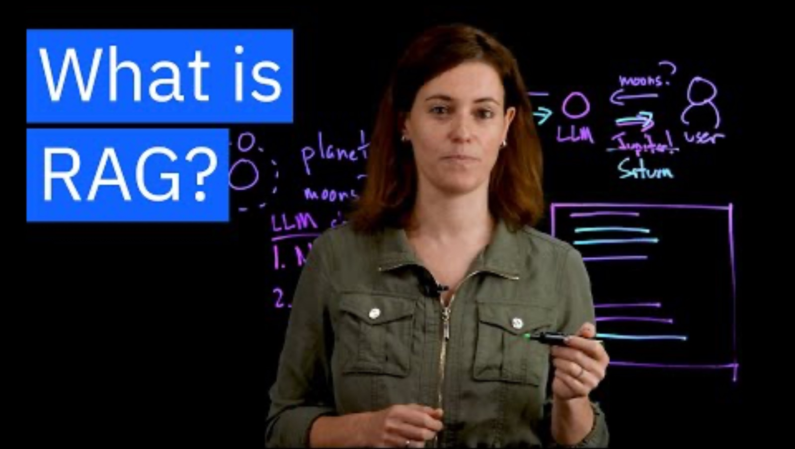
Education Video on RAG

Slide 13

Cloud Services for RAG
Flexible Hosting
Intelligent APIs
Seamless Integration
Leverage cloud platforms like AWS, Azure, or Google Cloud to host your educational AI applications, ensuring scalability and reliability.
Integrate cloud-based AI services, such as natural language processing and machine learning, to enhance the capabilities of your educational tools.
Connect your educational AI applications with popular cloud-based tools and services, enabling a seamless user experience.

Slide 14

Unleash the Potential of No-Code Chatbots
1
Conversational Learning
2
Effortless Development
Empower students with interactive chatbots that can answer questions, provide personalized guidance, and facilitate engaging discussions.
Leverage no-code chatbot platforms like Dialogflow, Botkit, or Rasa to create sophisticated educational chatbots without extensive coding skills.
3
Adaptive Experiences
Implement chatbots that can adapt to individual student needs, providing tailored support and recommendations.

Slide 15




Designing Engaging UI for RAG Apps
Scheduling
Personalization
Progress Tracking
Collaboration
Integrate calendars and scheduling tools to help students manage their learning activities and deadlines.
Customize the user interface to reflect individual preferences and learning styles, enhancing engagement and motivation.
Provide visual representations of student progress, allowing them to track their growth and achievements.
Enable seamless collaboration between students and educators through shared workspaces and communication tools.

Slide 16
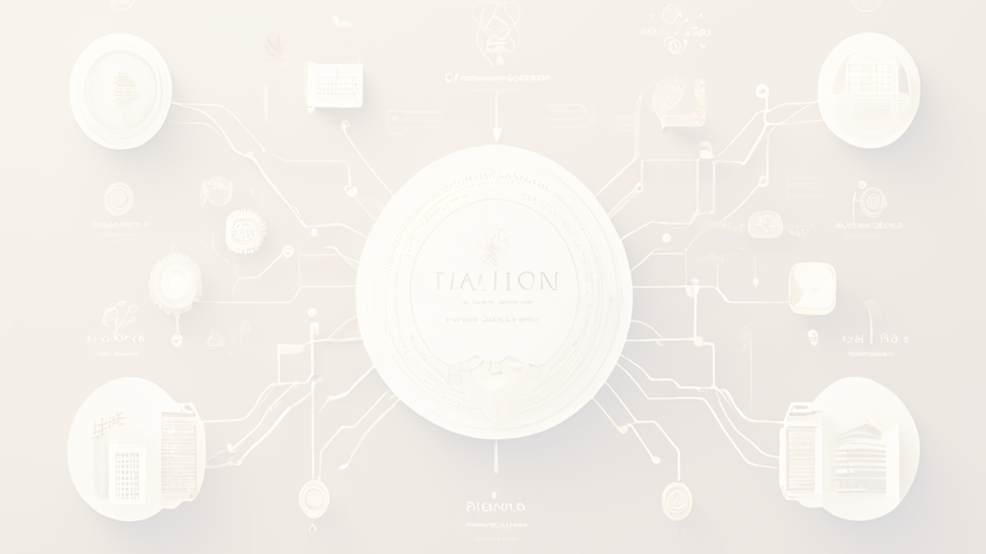



Integrating with Existing Platforms
LMS Integration
Collaborative Apps
Mobile-Friendly
Integrate your educational AI applications with popular Learning Management Systems (LMS) like Canvas, Moodle, or Blackboard.
Leverage cloud-based collaboration tools, such as Google Workspace or Microsoft 365, to enhance the learning experience.
Ensure your educational AI applications are accessible and optimized for mobile devices, enabling learning on-the-go.

Slide 17
Leveraging No-Code Platforms
Bubble
Appian
A powerful no-code platform for building fully functional web applications, including educational AI chatbots and interactive user interfaces.
Offers a comprehensive suite of tools for creating enterprise-level applications, including AI-powered chatbots and intelligent workflows.
Webflow
Zapier
A no-code web design platform that enables the creation of visually stunning, responsive educational AI applications.
Automate various tasks and integrate multiple cloud-based tools and services to streamline your educational AI development.

Slide 18
Harnessing the Power of Open-Source Tools
OpenAI GPT-3
Powerful language model for natural language processing and generation
TensorFlow
Flexible open-source machine learning library for building AI models
Hugging Face Transformers
Open-source library for state-of-the-art natural language processing models
Rasa
Open-source conversational AI platform for building chatbots and assistants

Slide 19
Unlocking the Future of Educational AI
Personalized Learning
1
Educational AI assistants that adapt to individual student needs, providing customized learning experiences.
2
Intelligent Tutoring
AI-powered tutors that can identify knowledge gaps, offer targeted feedback, and guide students through complex concepts.
Collaborative Innovation
3
Educational AI applications that foster teamwork, creativity, and problem-solving among students and educators.

Slide 20
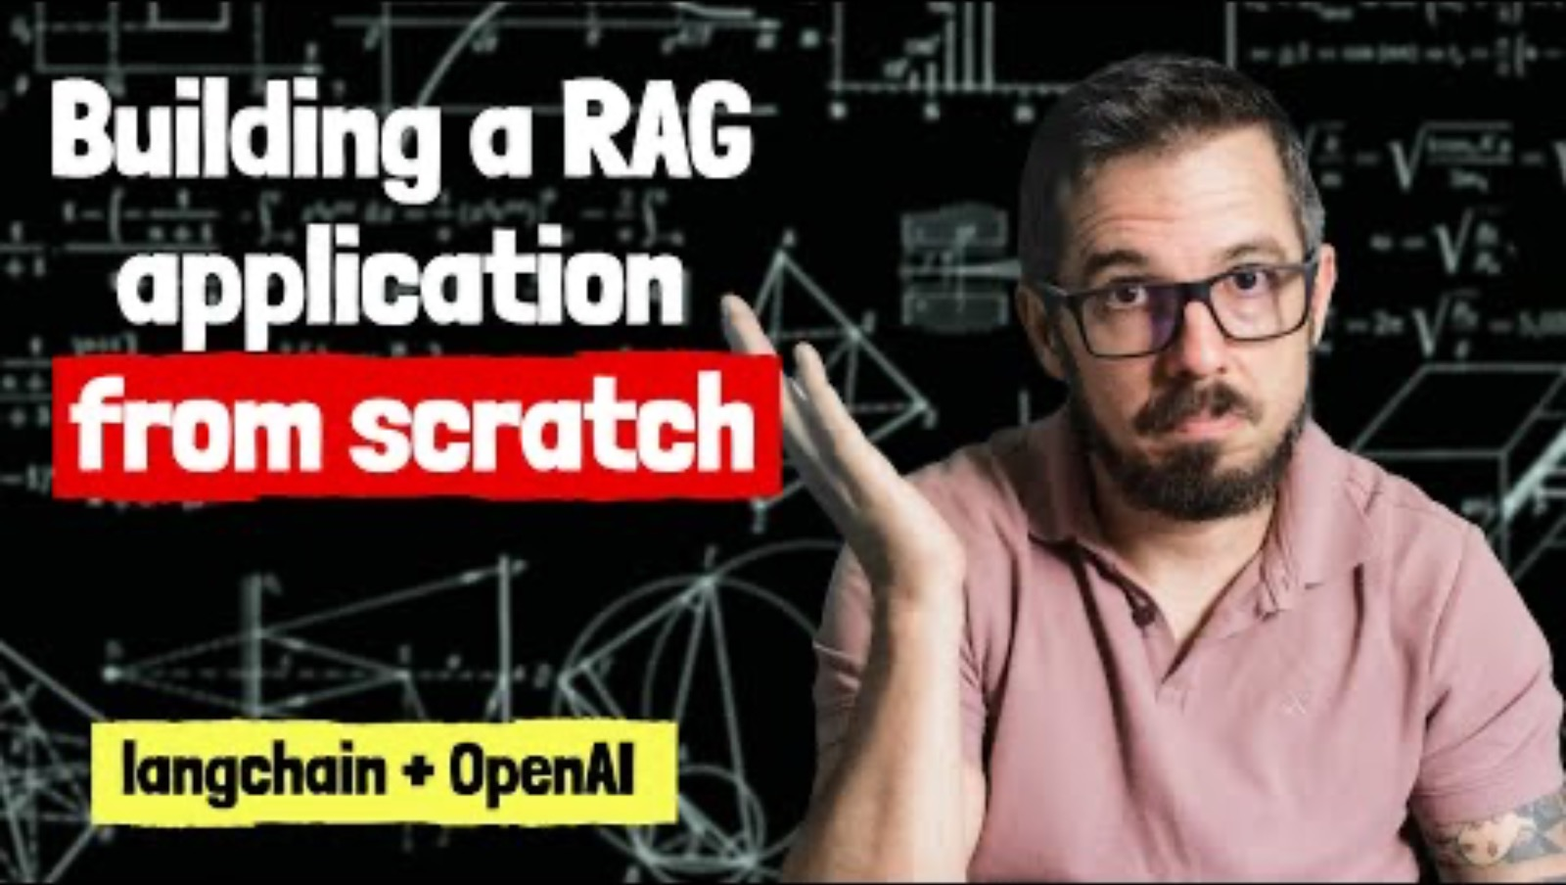
Building a RAG application from scratch using Python, LangChain, and the OpenAI API

Slide 21
Quiz questions on RAG
https://docs.google.com/document/d/1rKqjqh2svLgUyUHOSHJsH4Mt9sRJOVSeGyo1T8WNEkU/edit

Slide 22
References to learn about RAG
Here are some excellent resources where you can learn more about Retrieval-Augmented Generation (RAG):
NVIDIA Blogs: Offers a detailed explanation on RAG and explores its applications and technical aspects. [Learn more from NVIDIA Blogs]
https://blogs.nvidia.com/blog/2023/11/15/what-is-retrieval-augmented-generation/
AWS: Provides a comprehensive overview of how RAG works, including its integration with live data sources and the benefits of enhancing user trust and developer control.
https://aws.amazon.com/what-is/retrieval-augmented-generation/#:~:text=Retrieval%2DAugmented%20Generation%20(RAG),sources%20before%20generating%20a%20response.
Medium:
https://medium.com/@rajan.sethi36/rag-retrieval-argumentation-generation-c6d035c9e2a4
Coursera: Provides a project-based course where you can practically implement RAG, helping you understand both the theoretical and practical aspects of this technology.
https://www.coursera.org/projects/introduction-to-rag
IBM:
https://research.ibm.com/blog/retrieval-augmented-generation-RAG
These resources range from introductory explanations to hands-on projects, making them suitable for both beginners and those looking to deepen their understanding of RAG technology.

